Slide 1
GroupDocs.Viewer for .NET

Slide 2
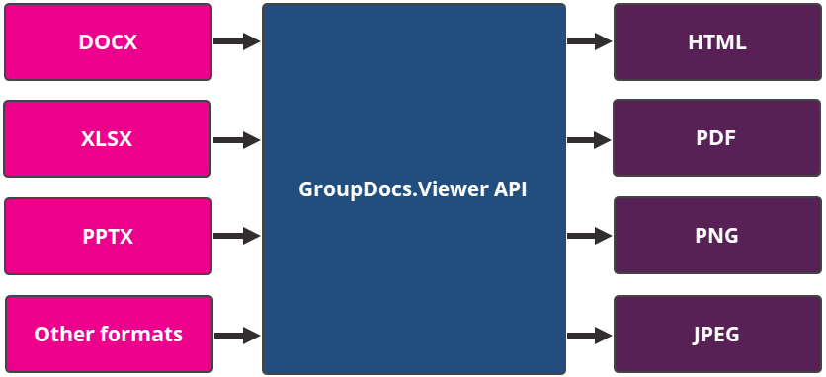
GroupDocs.Viewer Overview
GroupDocs.Viewer for .NET is a cross-platform library that allows you to create a file viewer application. You can load documents in the most popular file formats (including Microsoft Word, Microsoft Excel, Microsoft PowerPoint, and more) and render them as HTML, PDF, and image files.

